Slide 1
Federated Learning for Potato Leaf Disease Detection using CNN
Presented by-
Team no - 09
Rakib Hossain Rifat ID: 22366030
Marufa Kamal ID: 22366033
Abanti Chakraborty Shruti ID: 22366034
Ehsanur Rahman Rhythm
Md. Humaion Kabir Mehedi

Slide 2
Table of Contents
01
Introduction
02
Related Works
03
Dataset
04
Methodology
05
Experimental Setup and Results

Slide 3
01
Introduction

Slide 4
Introduction
Propose federated learning (FL) to detect potato leaf disease across two clients without sharing sensitive data between them
Each client are trained with the CNN model and its different architectures using their own dataset in this approach
The models are aggregated to create a global model and this global model is then used to detect potato leaf disease across multiple farms
Experiments are conducted using different custom and pre-trained CNN architectures
As our dataset, 2 datasets collected from Bangladesh[1][2] and Pakistan[3] are used

Slide 5
02
Related Works

Slide 6
Related Works
 | Year | Methods | Accuracy
Tiwari et al. [4] | 2020 | Feature selection -VGG19, VGG16, and InceptionV3 Classifiers - SVM, KNN, neural networks, and logistic regression | 97.8%
Iqbal et al. [5] | 2020 | Feature selection - global feature descriptors Classifiers - SVM, K-NN, LDA, Random Forest, Decision Tree, Naive Bayes | 97%
Agarwal et al. [6] | 2020 | CNN with 4 convolutional layer | 99.8%
Khalifa et al. [7] | 2021 | CNN with 14 layers | 98%
Afzaal et al. [8] | 2021 | GoogleNet, VGGNet, and EfficientNet | -

Slide 7
03
Dataset

Slide 8
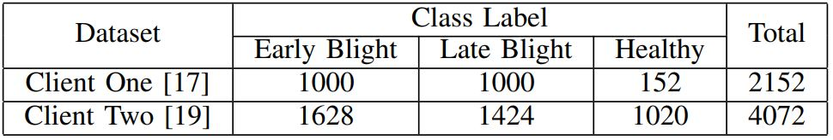
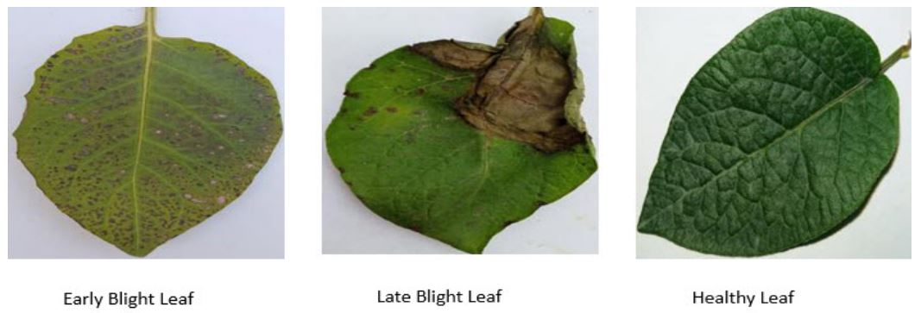
Dataset
The first dataset is collected from crops in the Bangladesh region [1], [2]. It contains images for different crop diseases
The second dataset contains images collected from potato production in Pakistan [3]
Table : Data Distribution of Training Dataset
Figure: Examples of the Images containing in the Dataset

Slide 9
04
Methodology

Slide 10
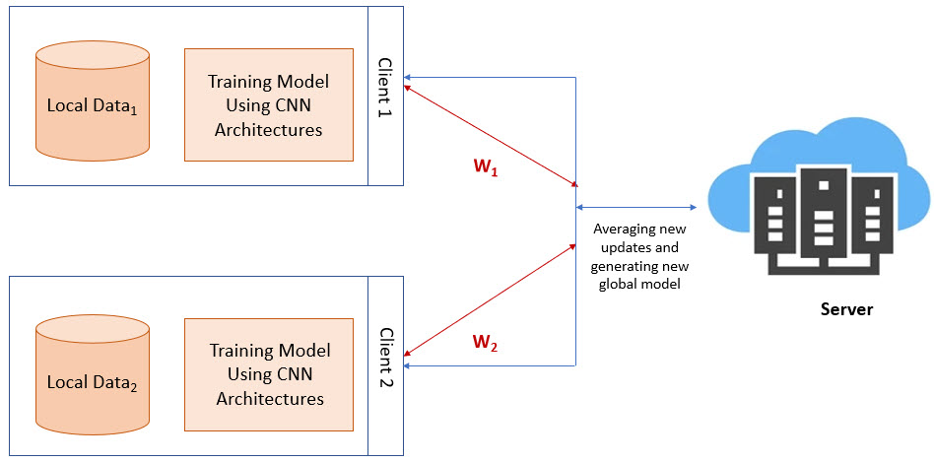
System Architecture

Slide 11
Client Side Model
VGG16
VGG19
Inception v3
consisting of 16 layers, including 13 convolutional layers and 3 fully connected layers.
employs a 3x3 filter for each conv. layer and a 2x2 max pooling window with a stride of 2.
a relatively quicker training and application process.
consists of 19 conv layers, followed by max-pooling layers and fully connected layers
learning rate of 0.0001, using the ReLU activation function.
Dropout rate of 0.2, and three dense layers of the Softmax
uses the Adam optimizer
Another pre-trained model developed by Google
Utilizes “inception modules” to capture features at various scales by utilizing multiple filter sizes within the same layer
Factorized 7x7 convolutions and batch normalization

Slide 12
Server Side Model
Step 1
Step 2
Step 3
The global model has initial weights
The training starts on the client side
Both the clients perform training on their local dataset
Clients aim to improve the model by reducing the categorical cross-entropy loss
Client side send these model weights to the server
Global model parameters are then updated
Computes an average weight and generates a new model
The local model weights are updated and then all the client weights are summed and passed to the global model

Slide 13
05
Experimental Setup and Results

Slide 14
Experimental Setup
Used Google Colab free GPU and python 3
Pandas, NumPy, sklearn, and TensorFlow keras libraries are used
For training our client-side models we have used a batch size of 8
Trained the model for 20 epochs
The learning rate was finalized at 0.0001
ReLU is used as the activation function
A softmax activation function is used at the output layer

Slide 15
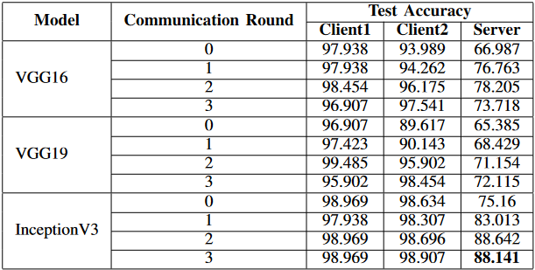
Results
Table : Test Results on the Pre trained Models

Slide 16
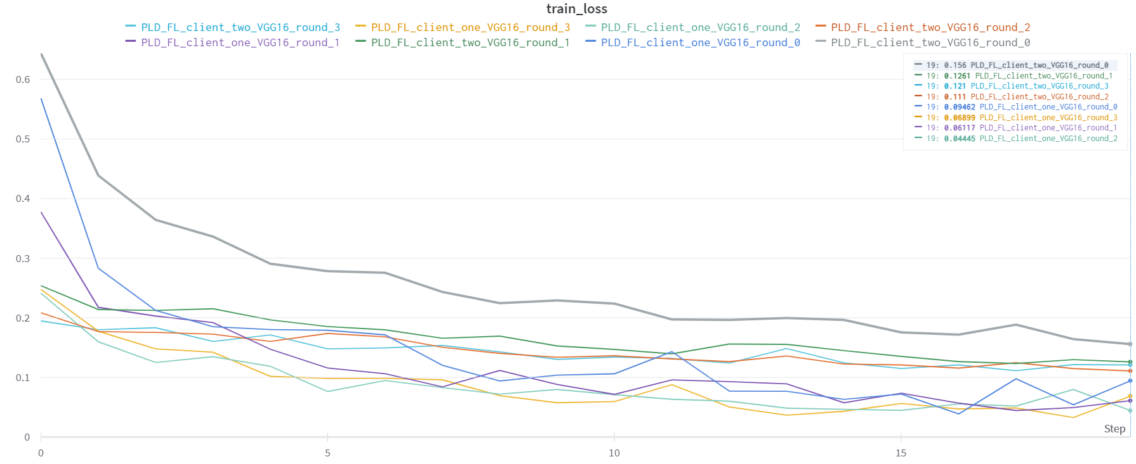
VGG-16 Training Loss

Slide 17
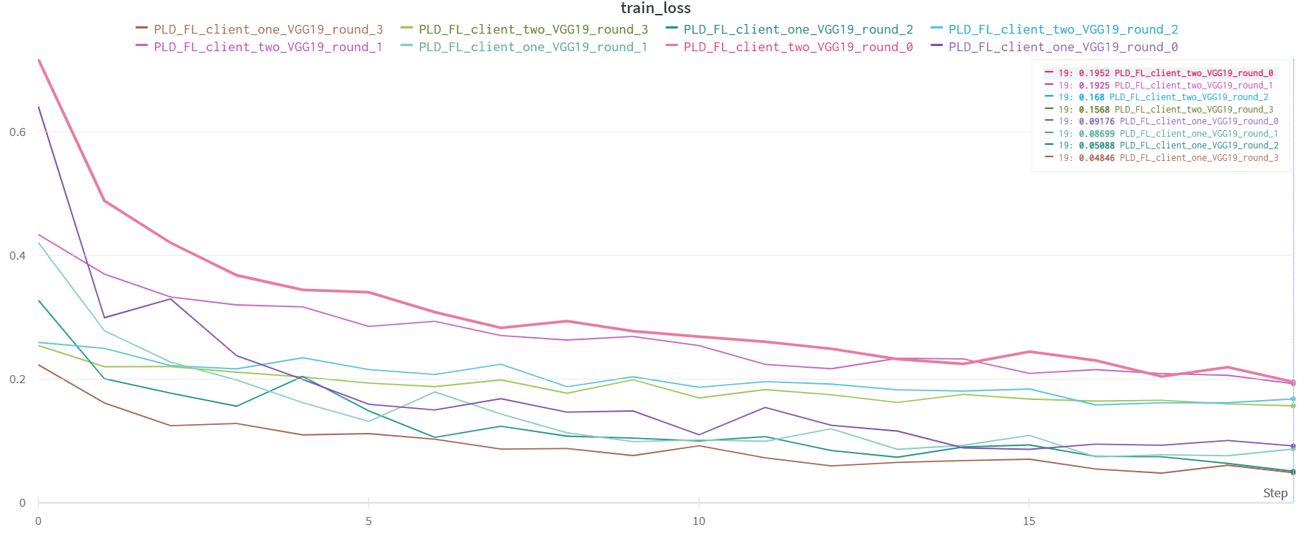
VGG-19 Training Loss

Slide 18
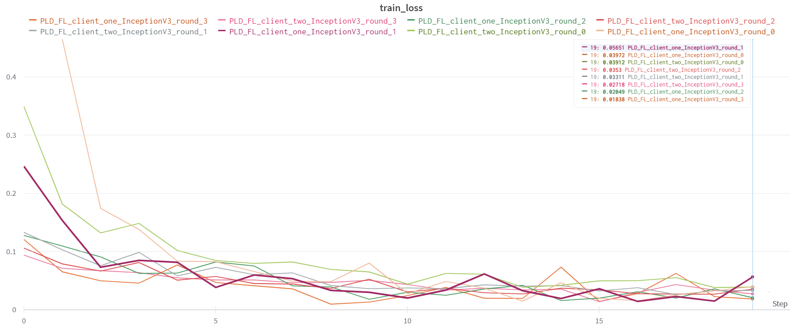
InceptionV3 Training Loss

Slide 19
Detailed Results
Model | Accuracy | Precision | Recall | F1-Score
VGG16 | 0.731 | 0.73 | 0.74 | 0.73
VGG19 | 0.721 | 0.71 | 0.73 | 0.71
Inception V3 | 0.881 | 0.89 | 0.89 | 0.88
Table: Test Results on Different Models
Model | Memory Usage (%) | Computational Time(min)
VGG16 | 10.25 | 160.067
VGG19 | 14.54 | 153.666
Inception V3 | 26.76 | 198.3
Table: Computational Results on Different Models

Slide 20
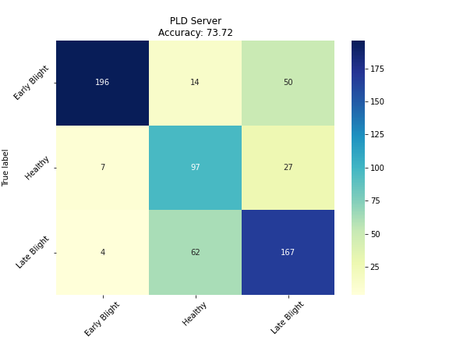
Confusion Matrix of VGG16
Correctly classifies most of Early Blight and Late Blight classes
Wrongly classified 27 healthy data points to late blight and 7 to early blight

Slide 21
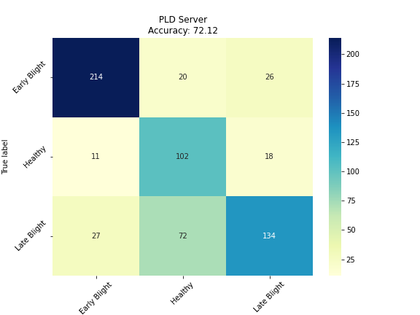
Confusion Matrix of VGG19
Correctly classifies most of Early Blight and Healthy classes
Wrongly classified 72 late blight data into healthy class

Slide 22
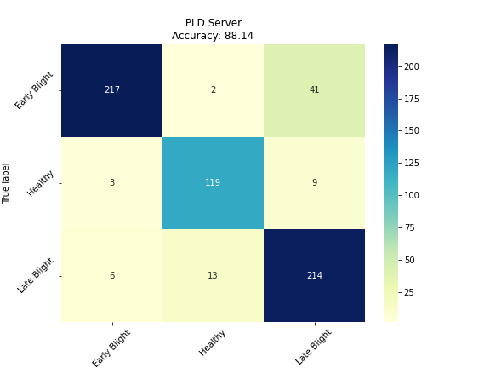
Confusion Matrix of Inception v3
Correctly classifies most of Healthy and Late Blight classes
Wrongly classified 41 early blight data points.

Slide 23
References
[1] D. Hughes, M. Salathe´ et al., “An open access repository of images on plant health to enable the development of mobile disease diagnostics,” arXiv preprint arXiv:1511.08060, 2015.
[2] “New bangladeshi crop disease,” https://www.kaggle.com/datasets/ nafishamoin/new-bangladeshi-crop-disease.
[3] J. Rashid, I. Khan, G. Ali, S. H. Almotiri, M. A. AlGhamdi, and K. Masood, “Multi-level deep learning model for potato leaf disease recognition,” Electronics, vol. 10, no. 17, p. 2064, 2021
[4] D. Tiwari, M. Ashish, N. Gangwar, A. Sharma, S. Patel, and S. Bhardwaj, “Potato leaf diseases detection using deep learning,” in 2020 4th International Conference on Intelligent Computing and Control Systems(ICICCS). IEEE, 2020, pp. 461–466.
[5]M. A. Iqbal and K. H. Talukder, “Detection of potato disease using image segmentation and machine learning,” in 2020 International Conference on Wireless Communications Signal Processing and Networking (WiSPNET). IEEE, 2020, pp. 43–47.
[6]M. Agarwal, A. Sinha, S. K. Gupta, D. Mishra, and R. Mishra, “Potato crop disease classification using convolutional neural network,” in Smart Systems and IoT: Innovations in Computing: Proceeding of SSIC 2019. Springer, 2020, pp. 391–400.
[7]N. E. M. Khalifa, M. H. N. Taha, L. M. Abou El-Maged, and A. E. Hassanien, “Artificial intelligence in potato leaf disease classification: a deep learning approach,” Machine Learning and Big Data Analytics Paradigms: Analysis, Applications and Challenges, pp. 63–79, 2021.
[8]H. Afzaal, A. A. Farooque, A. W. Schumann, N. Hussain, A. McKenzie Gopsill, T. Esau, F. Abbas, and B. Acharya, “Detection of a potato disease (early blight) using artificial intelligence,” Remote Sensing, vol. 13, no. 3, p. 411, 2021.

Slide 24
Thank You

